Slide 1

Illinois Performance Evaluation Advisory Council Update
Illinois State Board of Education (ISBE)
Illinois Performance Evaluation Advisory Council (PEAC)

Slide 2

Educator Performance Evaluation in Illinois
Evaluation reforms provide statewide consistency while offering local districts the opportunity to create their own evaluation systems that meet state rules.
Design is based on the PERA legislation and the Administrative Rules found in Part 50. Go to www.isbe.net/rules
Notes:
It supports teachers and principals in their quest to provide the best education possible to Illinois students, because teachers and leadership matters. In so doing, it helps us do right by our students.
Multiple measures of student growth and professional practice will be used to create clear pictures of educator performance.
District personnel who will conduct evaluations must undergo rigorous training to pre-qualify them to ensure they have the skills to conduct observations, assess professional practice, collect evidence and provide useful feedback to educators.
Fairness and objectivity in the evaluation process should be increased, addressing a longstanding concern of educators.
Evaluations are intended to be an opportunity for growth, rather than a “gotcha” system. PERA is separate from Senate Bill 7 and is about supporting a framework of effective teaching.

Slide 3

Educator Performance Evaluation in IL—Built on Collaboration
Teacher Evaluation based on the evaluation of teacher practice and student growth with % of each depending on either the agreement between union and district or use of the state model.
The Performance Evaluation Advisory Council (PEAC) is the group assigned the responsibility to advise ISBE on implementation.

Slide 4
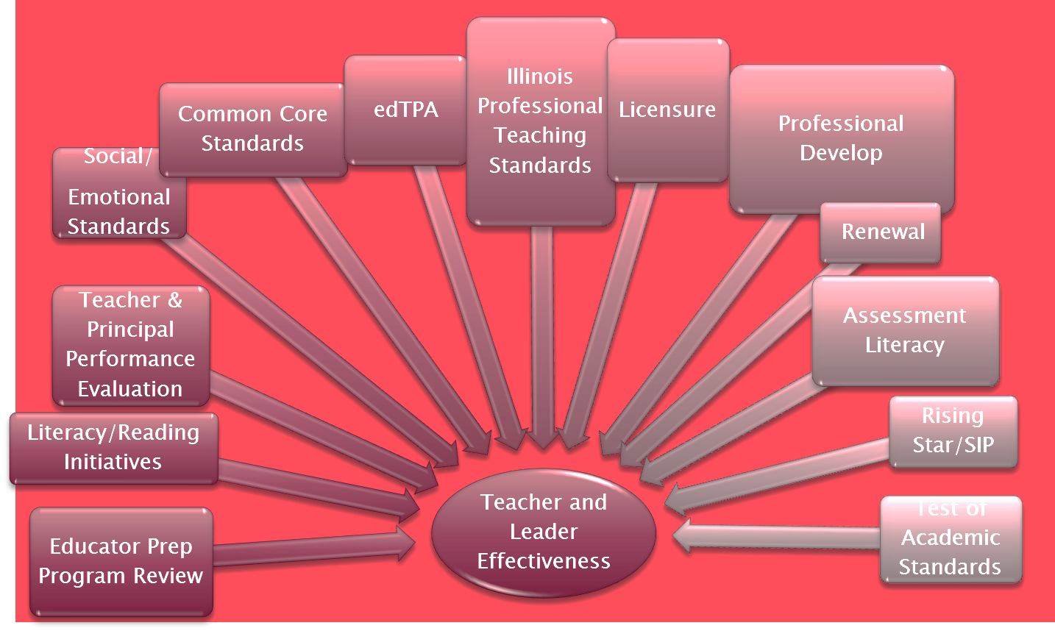

Slide 5
PEAC Work-To-Date
Made recommendations for Part 50 of Administrative Rules (www.isbe.net) for districts to be able to implement the PERA legislation including:
  Recommendation of the Danielson Framework for Teaching for the measurement of teacher practice
  Designed the Type I, Type II, and Type III Assessment framework for the implementation of student growth within the evaluations of teachers and principals
Developed a state model for principal evaluation
Supported training of evaluators statewide
Provides ongoing guidance through online resources

Slide 6
PEAC Discussion Topics
Other Ongoing Discussion Topics
  Details of the measurement of student growth especially surrounding Type I Assessments
  Evaluator training
  Recalibration of evaluators
  Peer evaluation
  Evaluation of Special Education Teachers
  Assessment Literacy

Slide 7

General Notes about Implementation
Evaluation of Teacher Practice—rules state must be aligned to IPTS
PEAC recommends the use of Danielson’s Framework for Teacher which is directly aligned to edTPA
Use of Student Growth requires knowledge of assessment to show students are progressing—most effective when using assessments from the classroom other than Type I

Slide 8

PEAC Guidance for Districts to date . . .
PEAC has developed guidance on the following topics:
  Guidance on 5 Essentials Survey in Principal Evaluation Systems
  Guidance on Collecting Evidence of Non-Observable Elements of Teacher Practice in Teacher Evaluation Systems
  Guidance on District Decision Making for Teacher Evaluation Systems
  Guidance on the evaluation of first-year principals and the use of student growth measures
Notes:
These guidance documents are available on the PEAC pages of the ISBE website

Slide 9

PEAC Guidance for Districts . . . continued
  Guidance on Student Learning Objectives (for use with Type III Assessments) in Teacher Evaluation Systems
  Guidance on Alignment of Rising Star Indicators, 5 Essentials Learning Conditions Survey and Illinois Performance Standards for School Leaders Rubric in Principal Evaluation Systems
  Guidance on Creating a Summative Rating in Teacher Evaluation Systems
Notes:
These guidance documents will be available on the PEAC pages of the ISBE website in February 2013.

Slide 10
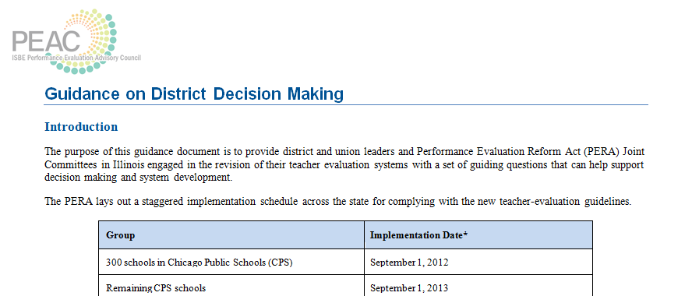
Guidance on Decision Making

Slide 11
PEAC Work on the State Model Teacher Evaluation System
PEAC is working on recommendations to ISBE on the following topics for districts for the model system:
  Model Teacher Evaluation System: Type I Assessments for Student Growth
  Model System Teacher Evaluation System: Measuring Growth for Type III Assessments using Student Learning Objectives
  ISBE is also working on a project called the LAS == Learning Assessment System that will be rolled out to assist as well
Notes:
These model documents will be available on the PEAC pages of the ISBE website in February 2013.

Slide 12
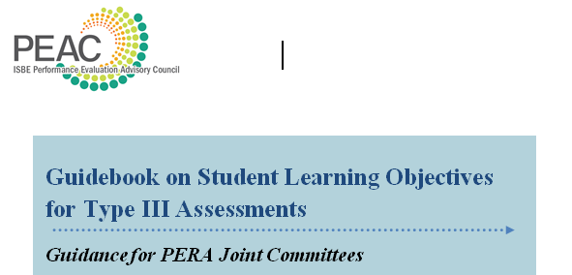
Guidance Document on Type III Assessements and SLO’s

Slide 13
Goals for Summer & Fall 2013
Guidance on operating guidelines for a student growth model
Guidance on peer evaluation
    guidance document is available on the website now
Guidance for special education, ELL, and early childhood teachers
Guidance for Type II Assessments, especially grades subjects without a Type I Assessment
Encourage more teachers and teacher leaders to get involved with the Growth Through Learning Illinois Teacher Evaluation Training.

Slide 14

Local Assessment Support System
Working toward a balanced assessment system to support students, teachers and administrators in continuous growth.

Slide 15

Local Assessment Support
Support standards implementation, improve instruction, and measure student growth for the purpose of teacher and administrator evaluation.
    CCSS and Illinois Learning Standards
    Assessment Literacy to Improve Instruction
    Alignment to Performance Evaluation Reform Act (PERA) and PEAC Recommendations

Slide 16

Framework Development and Training
Guide the selection and development of Type II and Type III assessments aligned to CCSS and Illinois Learning Standards;
Align to PERA and the PEAC recommendations for use in measuring student growth in teacher and principal evaluations;
Address appropriate use of selected and/or developed assessments, including for instructional, evaluative, predictive or multiple purposes;

Slide 17

Framework Development and Training continued . . .
Evaluate the technical quality of assessments, including item quality, as well as content and face validity;
Promote effective use of the assessments and results for instructional change;
Ensure appropriate methods for assessing English language learners and students with disabilities;
Provide resources for additional learning

Slide 18
Type II and III Assessments
RttT supported efforts will include hands-on development in non-tested grades and subjects utilizing the developed framework and guided by experts and working groups of teachers and administrators in the field
Developed assessments, performance tasks and assessment items will be subject to a trained peer-review process and approved items will be made available in a shared collaborative space
PEAC will also continue work around Type II and III assessments for both the State Model and guidance to districts
Notes:
Segue to what PEAC has already done as guidance to support districts in this process

Slide 19

ISBE Educator Evaluation Communication Efforts
Website updates
  Go to www.isbe.net/peac for ongoing updates and guidance documents
Statewide presentations
Superintendent’s weekly message

Slide 20

Teacher Evaluation Training
Contact your local Regional Office of Education if you would like to register for the Growth Through Learning Illinois Training. Funds are limited, but the ROE can take your request and notify you if funds have been allocated to pay for your training. Otherwise you can go to www.growththroughlearningillinois.org to register and pay with a credit card. The fee is $650.

Slide 21
Preparation and Evaluation
Vicki Phillips
vphillip@isbe.net

